Slide 1


Movie Recommendation System Using SparkML
Team Name: Telecom Techies
Authors: Amit Kadane, Ghanshyam Burnwal, Nitish Kumar, Shalin Shah
Affiliation: Indian Institute of Science, Bangalore
Email Address:
amitkadane@iisc.ac.in, ghanshyamb@iisc.ac.in, nitishkumar@iisc.ac.in, shalinshah@iisc.ac.in

Slide 2


Problem & Dataset
Problem Motivation & Definition
OTT content overload
Struggle to select meaningful content quickly
Create system which supports large scale data for recommendation
Reducing the Surfing time & providing integrated viewing experience
Small dataset
Big dataset
No. of movies – 9,000
No. of ratings – 100,000 (100K)
No. of tags – 3,600 (3.6K)
No. of users – 600
No. of movies – 86,000
No. of ratings – 33,000,000 (33M)
No. of tags – 2,000,000 (2M)
No. of users – 330,975

Slide 3










Research to Implementation Roadmap
Research on the topic
High Level Design
POC with small dataset
Big dataset
Popular movies
Content-based
Collaborative - ALS
Implementation
Testing
Performance Enhancements
Project Report & Presentation
Validation

Slide 4
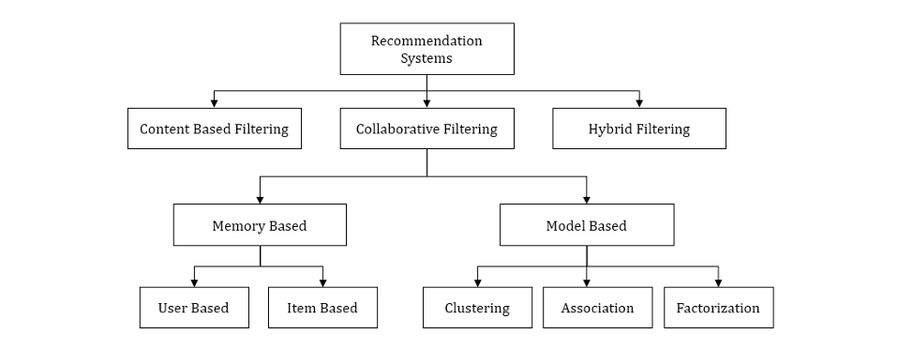
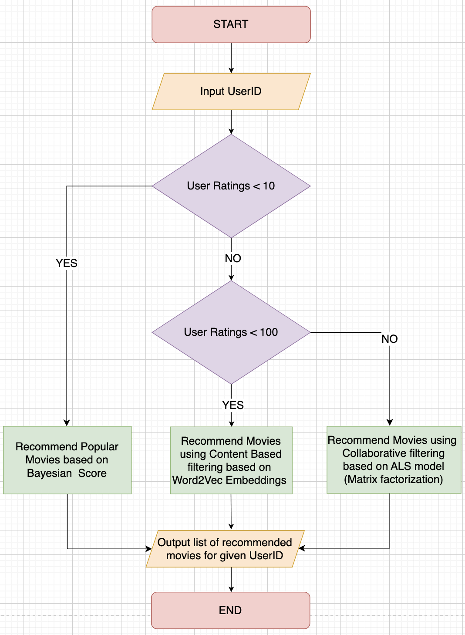
System Design
Typical Recommendation System
High-Level Design

Slide 5
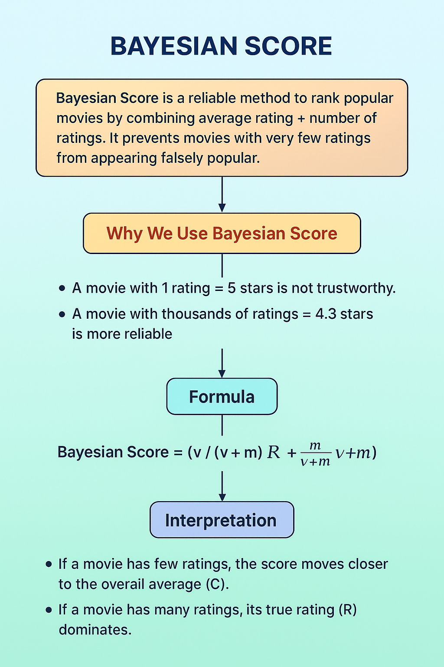

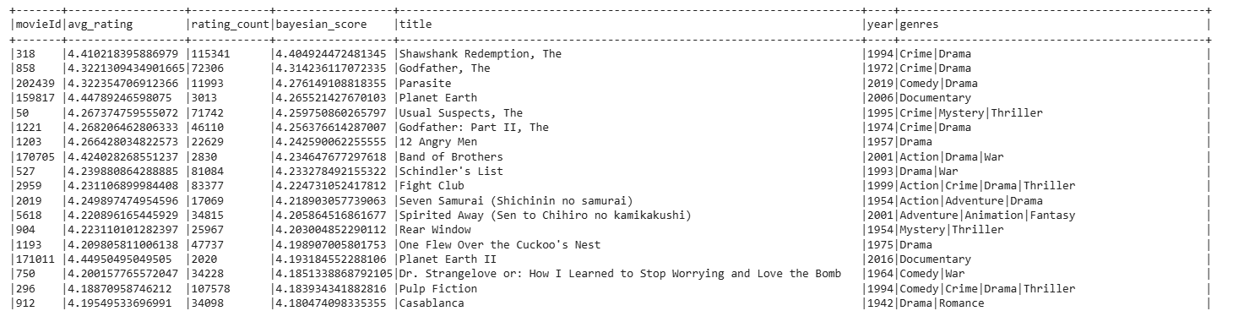
Popular movies logic (user ratings < 10)
Find Bayesian score of each movie based on its respective avg rating and rating count against overall avg rating and count
Find top 100 movies based on Bayesian score and cache in memory as popular movies dataframe
Find avg rating and total rating count based on movie id using ratings_df
Find overall avg rating count and avg movie rating
User ratings < 10
Show TOP N popular movies to user based on the input
USER JOURNEY

Slide 6
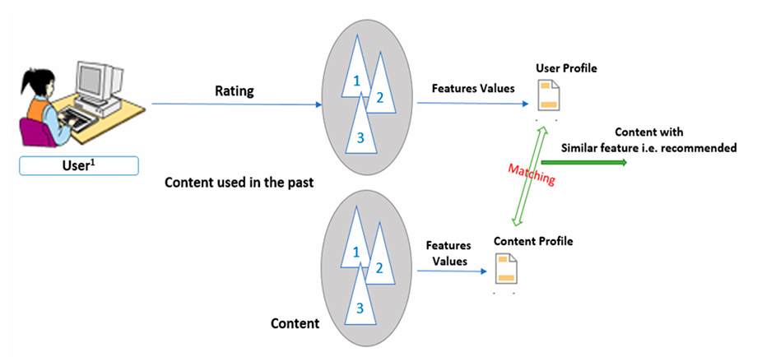

Content based filtering logic (10 <= user ratings < 100)
Create array with tags (tags_df) and genres (movies_df)
Create Word2Vec with VectorSize = 100 using the array
Normalize the vectors and save as parquet file on disk to use it later
User ratings >= 10
Create source vector using normalized content vector dataframe for movies rated by user
Find Cosine similarity between source vector and normalize content vector
Find TOP N movies not watched by user based on Cosine similarity
& < 100
USER JOURNEY

Slide 7
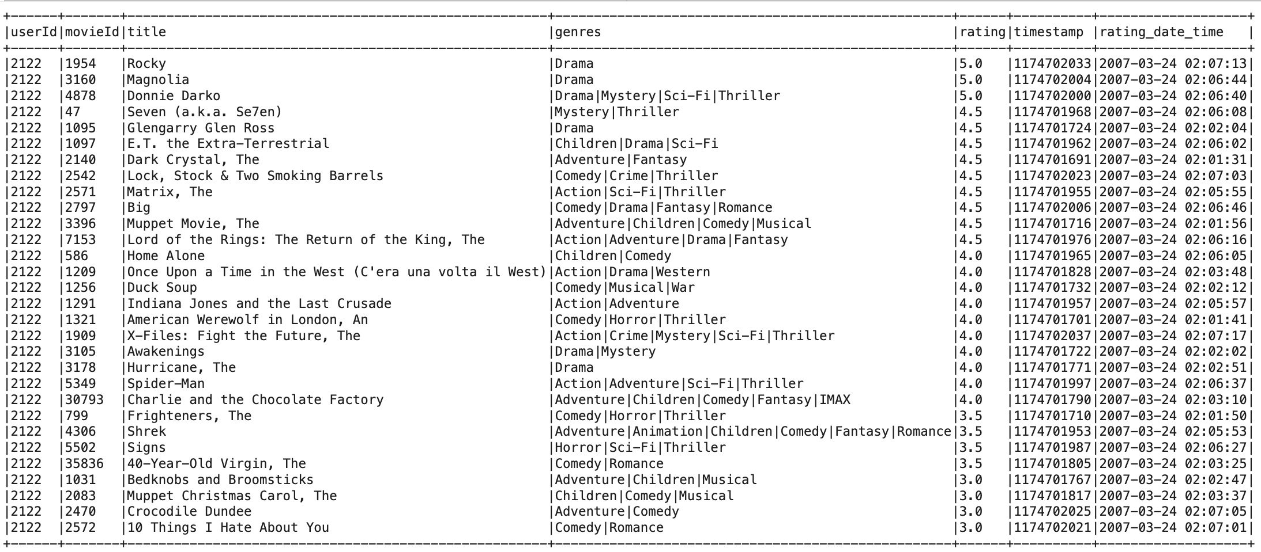
Content based filtering logic (10 <= user ratings < 100) – user rated movies data of userID 2122

Slide 8
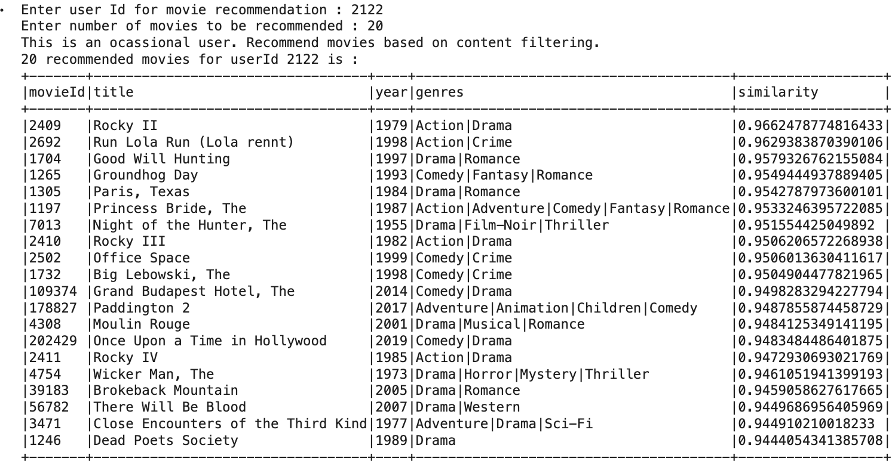
Content based filtering logic (10 <= user ratings < 100) – movie recommendations for userID 2122

Slide 9
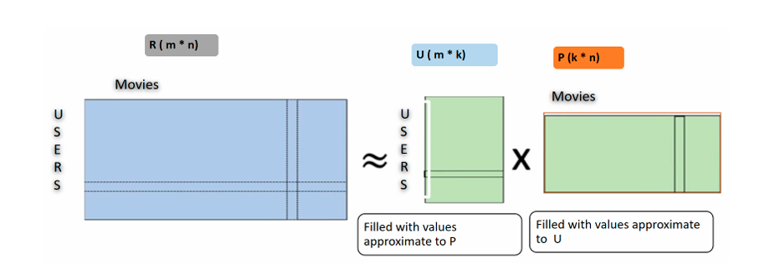
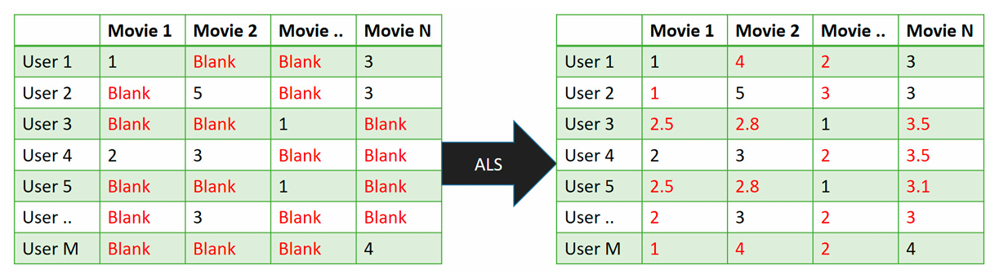
Collaborative filtering (user ratings >=100)
Create train and test dataframes ensuring proper split w.r.t. userId
Create ALS model using userId, movieId and rating
Save ALS model as
parquet file on disk
User ratings >= 100
Load ALS model from parquet file
Recommend TOP N movies based on ratings
USER JOURNEY

Slide 10
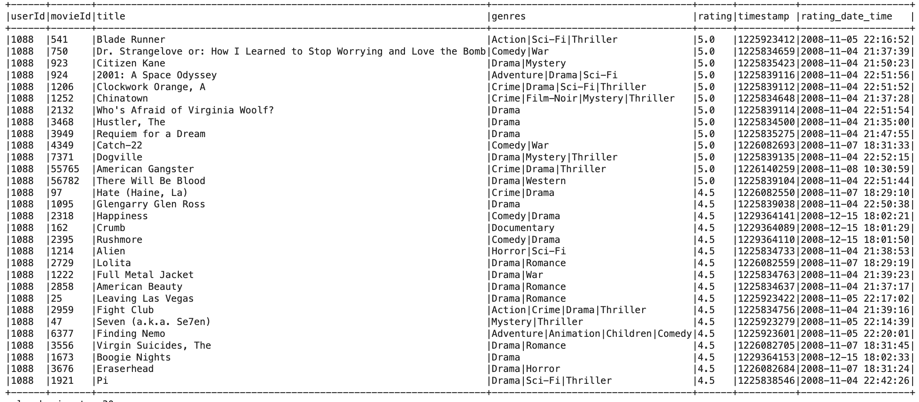
Collaborative filtering (user ratings >= 100) – user ratings data of userID 1088

Slide 11
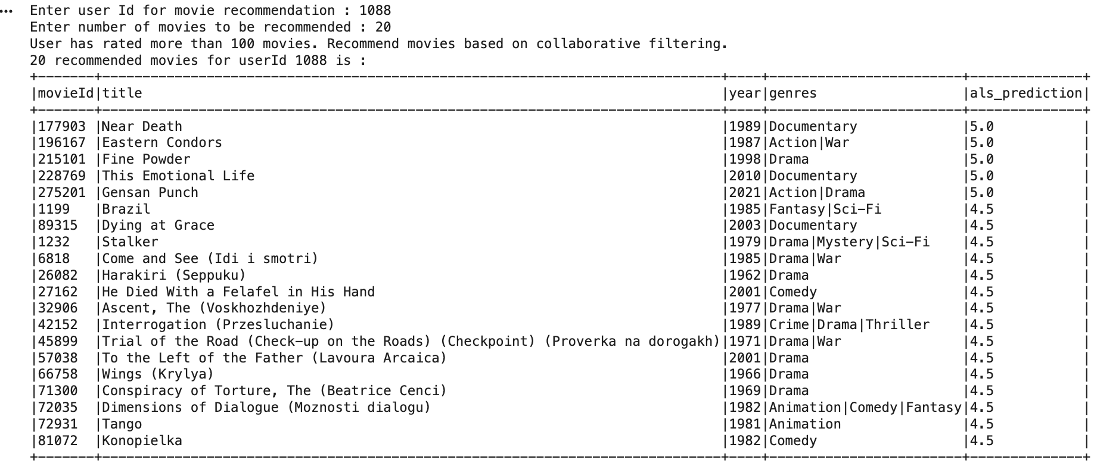
Collaborative filtering (user ratings >= 100) – movie recommendations for userID 1088

Slide 12

Challenges & Solutions
Challenges
Solutions
Data loading of ratings_df and tags_df was taking high time for big dataset.
Converted all csv files to Parquet files by taking one time hit and created dataframes using Parquet files.
ALS RMSE was 0.94 on the first run.
Improved RMSE to 0.826 by tuning hyperparameters with help of cross validator and RegressionEvaluator
Content based filtering using readily available models like Linear regression and GBTRegressor needs very high memory
Changed approach to recommend movies using content-based filtering with help of Word2Vec and Cosine similarity
ALS model on big dataset taking ~30 minutes.
Saved model as parquet file so that user recommendation can be run directly by loading the model from file at later stages.
Performance Improvements
Usage of broadcast to avoid shuffle wherever possible for small dataframes
Using window functionality for Top-N instead of full sort
Limiting rank and vector size to ensure filtering runs in reasonable time without compromising accuracy

Slide 13

Scalability/Performance metrics
 | Small Dataset | Big Dataset
Movies | 9K | 86K
Ratings | 100K | 33M
Tags | 3.6K | 2M
Users | 600 | 330K
Recommendation Algorithms | Training Time (Small Dataset) | Recommendation Time (Small Dataset) | Training Time (Big Dataset) | Recommendation Time (Big Dataset)
Collaborative filtering (ALS) | ~40 Secs | ~8 secs | ~20 mins (rank = 30) ~ 3 hours (rank = 100) | ~20 secs
Content based filtering | ~10 Secs | ~18 secs | ~2 mins | ~2 mins
Popular movies | ~9 secs | ~ 2 Secs | ~3 mins | ~20 secs
Key Insights
Collaborative Filtering (ALS) provides better personalization but is the slowest, especially on large datasets (up to 3 hours training for higher model ranks)
Content-Based Filtering offers a balanced trade-off — faster than ALS and still personalized, with training and prediction times in the seconds to minutes range
Popular Movies baseline is the fastest approach overall with very low computation time, making it useful for cold-start and fallback scenarios, but offers no personalization

Slide 14



Future Enhancements
Architecture-Level Improvements
Integrate Kafka for Streaming Ingestion Enable real-time data flow for continuous updates to user preferences and movie trends.
User-Friendly Recommendation Interface Build an intuitive UI/visualization layer to display personalized recommendations.
Design-Level Enhancements
Region-Based Recommendations Capture geographical preferences to improve personalization.
Include Rating Timestamp Factor in when the user rated a movie to understand evolving tastes.
Use Movie Release Year Recommend movies aligned with user’s preference for older classics or modern titles.
Incorporate User Device Information Tailor suggestions based on mobile/TV/laptop usage patterns.
Time-of-Day Based Personalization
Daytime → Horror/Thriller
Night/Bedtime → Light comedy, ROM-COM, feel-good movies
Leverage User Profile Metadata Age group, content maturity level preferences, subscription tier, etc.
Periodic Model Retraining and Updates Continuously refresh the ML models as new data streams in.
Expand Beyond Movies Extend recommendations to web series, TV shows, live sports, and trending events

Slide 15
References
https://medium.com/@prateekgaurav/step-by-step-content-based-recommendation-system-823bbfd0541c
A Recommendation Engine for Predicting Movie Ratings Using a Big Data Approach
https://www.researchgate.net/publication/347627362_A_review_of_movie_recommendation_system_Limitations_Survey_and_Challenges

